Slide 1

Basics of Data Communication Process of transmitting data from one point to another
Notes:
1
1
1

Slide 2
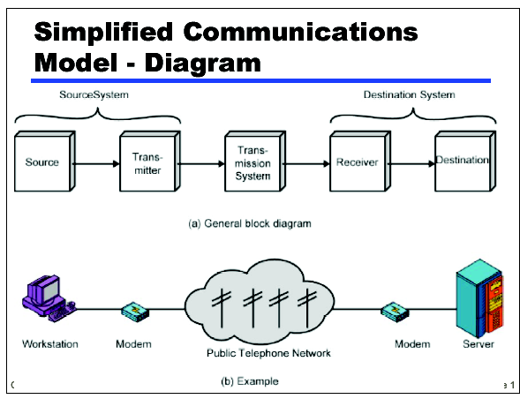
Notes:
2
2
2
2

Slide 3
Key elements in the model
Source: Device which generates the data to be transmitted
Transmitter: Device which transforms and encodes the information that needs to be transmitted
Transmission medium: provides the path for data communication
Receiver: Device which accepts the signal from the transmission media and converts in to a form that can be handled by the destination device
Destination: Takes the incoming data from the receiver
Notes:
3
3
3
3

Slide 4
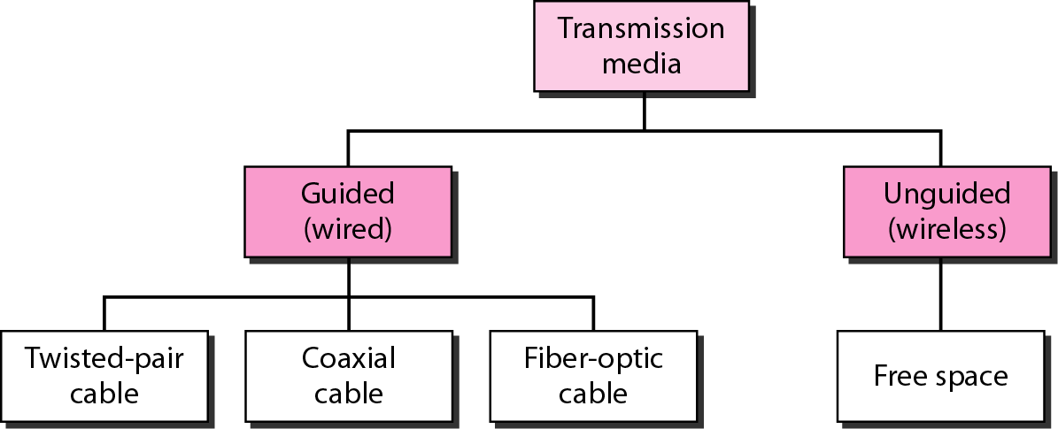
Transmission Medium medium and physical layer

Slide 5
Protocol “Layers”
Networks are complex!
many “pieces”:
hosts
routers
links of various media
applications
protocols
hardware, software
Protocol is a set of rules that govern a data communication.

Slide 6
Organization of air travel
ticket (purchase)
baggage (check)
gates (load)
runway takeoff
airplane routing
ticket (complain)
baggage (claim)
gates (unload)
runway landing
airplane routing
airplane routing
a series of steps

Slide 7
Layering of airline functionality
ticket (purchase)
baggage (check)
gates (load)
runway (takeoff)
airplane routing
ticket (complain)
baggage (claim
gates (unload)
runway (land)
airplane routing
ticket
baggage
gate
takeoff/landing
airplane routing
airplane routing
airplane routing
departure
airport
intermediate air-traffic
control centers
arrival
airport
Layers: each layer implements a service
via its own internal-layer actions
relying on services provided by layer below

Slide 8
Why layering?
Dealing with complex systems:
explicit structure allows identification, relationship of complex system’s pieces
modularization eases maintenance, updating of system
change of implementation of layer’s service transparent to rest of system
e.g., change in gate procedure doesn’t affect rest of system

Slide 9
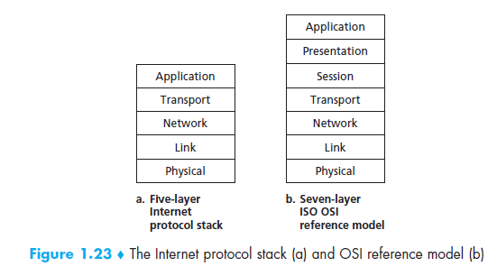
Protocol Stack

Slide 10
OSI MODEL
An ISO standard that covers all aspects of network communications is the Open Systems Interconnection (OSI) model.
It was first introduced in the late 1970s.
An open system is a set of protocols that allows any two different systems to communicate regardless of their underlying architecture.
The OSI model is not a protocol;
it is a model for understanding and designing a network architecture that is flexible, robust, and interoperable.

Slide 11
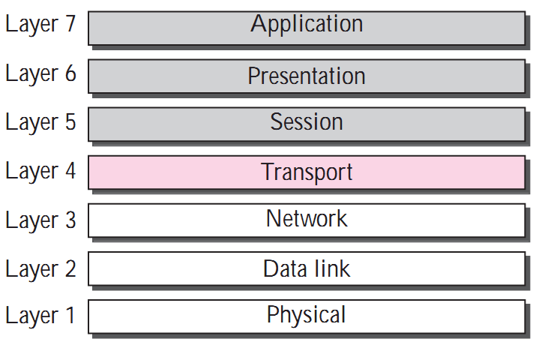
Layered Architecture

Slide 12
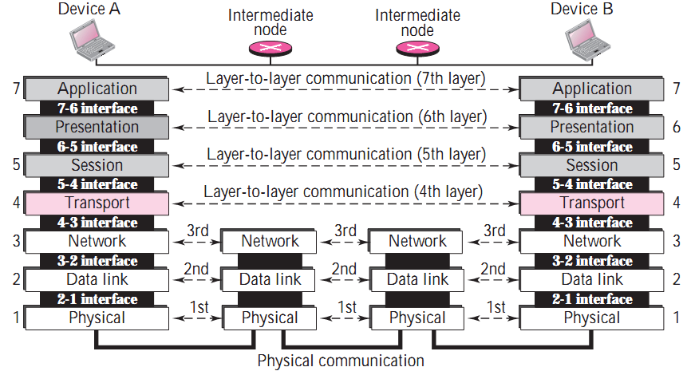
OSI layers

Slide 13
Organization of the Layers
The seven layers can be thought of as belonging to three subgroups.
Layers 1, 2, and 3- physical, data link, and network - are the network support layers; they deal with the physical aspects of moving data from one device to another (such as electrical specifications, physical connections, physical addressing, timing ).
Layers 5, 6, and 7- session, presentation, and application - can be thought of as the user support layers; they allow interoperability among unrelated software systems.
Layer 4, the transport layer, links the two subgroups and ensures that what the lower layers have transmitted is in a form that the upper layers can use.

Slide 14
OSI Application Layer
The application layer enables the user, whether human or software, to access the network.
It provides user interfaces and support for services such as electronic mail, remote file access and transfer, shared database management, and other types of distributed information services.

Slide 15
Application Layer protocols example
Application Layer
There is a need for support protocols, to allow the applications to function
Some network applications
DNS: handles naming within the Internet
POP – IMAP – SMTP: handle electronic mail
FTP: File Transfer over the Internet
WWW – HTTP: Web world
Multimedia

Slide 16
OSI Presentation Layer
The presentation layer is concerned with the syntax and semantics of the information exchanged between two systems.

Slide 17
OSI Presentation Layer
Translation
Encryption
Compression

Slide 18
OSI Presentation Layer
Specific responsibilities of the presentation layer include the following:
Translation.
The presentation layer at the sender changes the information from its sender-dependent format into a common format.
The presentation layer at the receiving machine changes the common format into its receiver-dependent format.

Slide 19
OSI Presentation Layer
Encryption
To carry sensitive information a system must be able to assure privacy.
Encryption means that the sender transforms the original information to another form and sends the resulting message out over the network.
Decryption reverses the original process to transform the message back to its original form.

Slide 20
OSI Presentation Layer
Compression.
Data compression reduces the number of bits contained in the information.
Data compression becomes particularly important in the transmission of multimedia such as text, audio, and video.

Slide 21
OSI: Session Layer
It establishes, maintains, and synchronizes the interaction between communicating systems. (applications).
The session layer defines how to start, control and end conversations (called sessions) between applications.
Specific responsibilities of the session layer include the following:

Slide 22
OSI: Session Layer
Dialog control.
Synchronization.

Slide 23
OSI: Session Layer
Dialog control. The session layer allows two systems to enter into a dialog.
It allows the communication between two processes to take place in either half- duplex (one way at a time) or full-duplex (two ways at a time) mode.
Synchronization. The session layer allows a process to add checkpoints (synchronization points) into a stream of data.

Slide 24
OSI: Transport Layer
The transport layer is responsible for process-to-process delivery of the entire message.
A process is an application program running on the host.
Whereas the network layer oversees source-to-destination delivery of individual packets, it does not recognize any relationship between those packets.
It treats each one independently, as though each piece belonged to a separate message, whether or not it does.

Slide 25
OSI: Transport Layer
The transport layer, on the other hand, ensures that the whole message arrives intact and in order, overseeing both error control and flow control at the source-to-destination level.

Slide 26
OSI: Transport Layer
Service-point addressing
Segmentation and reassembly
Connection control
Flow control
Error control

Slide 27
OSI: Transport Layer
Other responsibilities of the transport layer include the following:
Service-point addressing
Computers often run several programs at the same time.
For this reason, source-to-destination delivery means delivery not only from one computer to the next but also from a specific process (running program) on one computer to a specific process (running program) on the other.

Slide 28
OSI: Transport Layer
Service-point addressing
The transport layer header must therefore include a type of address called a service-point address (or port address).
The network layer gets each packet to the correct computer; the transport layer gets the entire message to the correct process on that computer.

Slide 29
OSI: Transport Layer
Segmentation and reassembly
A message is divided into transmittable segments, with each segment containing a sequence number.
These numbers enable the transport layer to reassemble the message correctly upon arriving at the destination and to identify and replace packets that were lost in transmission.

Slide 30
OSI: Transport Layer
Connection control
The transport layer can be either connectionless or connection- oriented.
A connectionless transport layer treats each segment as an independent packet and delivers it to the transport layer at the destination machine.
A connection- oriented transport layer makes a connection with the transport layer at the destination machine first before delivering the packets. After all the data are transferred, the connection is terminated.

Slide 31
OSI: Transport Layer
Flow control.
Like the data link layer, the transport layer is responsible for flow control.
However, flow control at this layer is performed end to end rather than across a single link.

Slide 32
OSI: Transport Layer
Error control.
Like the data link layer, the transport layer is responsible for error control.
However, error control at this layer is performed process-to-process rather than across a single link.
The sending transport layer makes sure that the entire message arrives at the receiving transport layer without error (damage, loss, or duplication).
Error correction is usually achieved through retransmission.

Slide 33
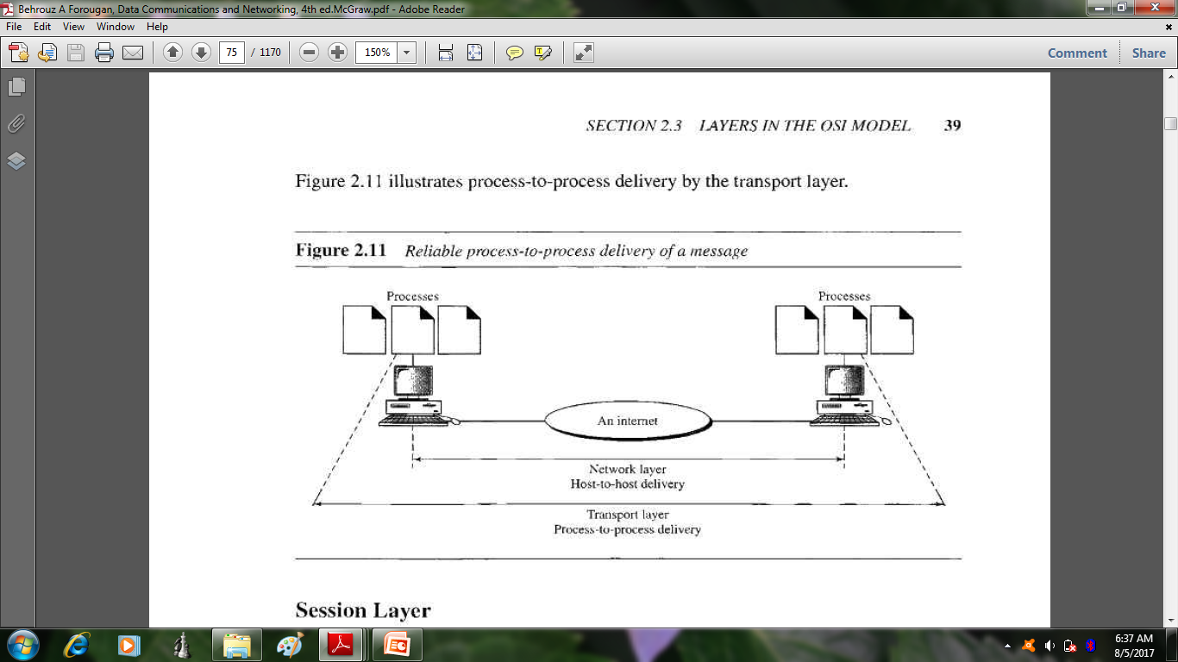
Transport Layer: process to process delivery

Slide 34
OSI: Network Layer
The network layer is responsible for the source-to-destination delivery of a packet, possibly across multiple networks (links).
Whereas the data link layer oversees the delivery of the packet between two systems on the same network (link), the network layer ensures that each packet gets from its point of origin to its final destination.

Slide 35
OSI: Network Layer
Logical addressing
Routing

Slide 36
OSI: Network Layer
If two systems are connected to the same link, there is usually no need for a net-work layer.
if the two systems are attached to different networks (links) with connecting devices between the networks (links), there is often a need for the network .
Logical addressing.
The physical addressing implemented by the data link layer handles the addressing problem locally.
If a packet passes the network boundary, we need another addressing system to help distinguish the source and destination systems.
The network layer adds a header to the packet coming from the upper layer that, among other things, includes the logical addresses of the sender and receiver.

Slide 37
OSI: Network Layer
Routing.
When independent networks or links are connected together to create internetworks (network of networks) or a large network, the connecting devices (called routers or switches) route or switch the packets to their final destination.
One of the functions of the network layer is to provide this mechanism.

Slide 38
OSI DATA Link Layer
Framing
Physical addressing.
Flow control.
Error control.
Access control

Slide 39
OSI: Data Link Layer
Framing. The data link layer divides the stream of bits received from the network layer into manageable data units called frames.
Physical addressing. If frames are to be distributed to different systems on the network, the data link layer adds a header to the frame to define the sender and/or receiver of the frame. If the frame is intended for a system outside the sender's network, the receiver address is the address of the connecting device that connects the network to the next one.

Slide 40
OSI: Data Link Layer
Flow control. If the rate at which the data is absorbed by the receiver is less than the rate produced at the sender, the data link layer imposes a flow control mechanism to prevent overwhelming the receiver.
Error control. The data link layer adds reliability to the physical layer by adding mechanisms to detect and retransmit damaged or lost frames.
It also uses a mechanism to recognize duplicate frames.
Error control is normally achieved through a trailer added to the end of the frame.
Access control: when two or more devices are connected to the same link, data link layer protocols are necessary to determine which device has control over the link at any given time.

Slide 41
Physical Layer
The physical layer coordinates the functions required to carry a bit stream over a physical medium.

Slide 42
OSI Physical Layer
Physical characteristics of interfaces and media.
Representation of bits.
Data rate.
Synchronization of bits.
Line configuration.
Physical topology.
Transmission mode.

Slide 43
OSI :Physical Layer
The physical layer is also concerned with the following:
Physical characteristics of interfaces and media. The physical layer defines the characteristics of the interface between the devices and the transmission media. It also defines the type of transmission media.
Representation of bits. The physical layer data consists of a stream of bits (sequence of 0s or 1s) with no interpretation. To be transmitted, bits must be encoded into signals . The physical layer defines the type of encoding (how 0s and 1s are changed to signals).

Slide 44
OSI :Physical Layer
Data rate. The transmission rate - the number of bits sent each second—is also defined by the physical layer. In other words, the physical layer defines the duration of a bit, which is how long it lasts.
Synchronization of bits. The sender and receiver must not only use the same bit rate but must also be synchronized at the bit level. In other words, the sender and the receiver clocks must be synchronized.

Slide 45
OSI :Physical Layer
Line configuration. The physical layer is concerned with the connection of devices to the media. In a point-to-point configuration, two devices are connected together through a dedicated link. In a multipoint configuration, a link is shared between several devices.
Physical topology. The physical topology defines how devices are connected to make a network. Devices can be connected using a mesh topology (every device connected to every other device), a star topology (devices are connected through a central device), a ring topology (each device is connected to the next, forming a ring), or a bus topology (every device on a common link).

Slide 46
OSI :Physical Layer
Transmission mode. The physical layer also defines the direction of transmission between two devices: simplex, half-duplex, or full-duplex.

Slide 47
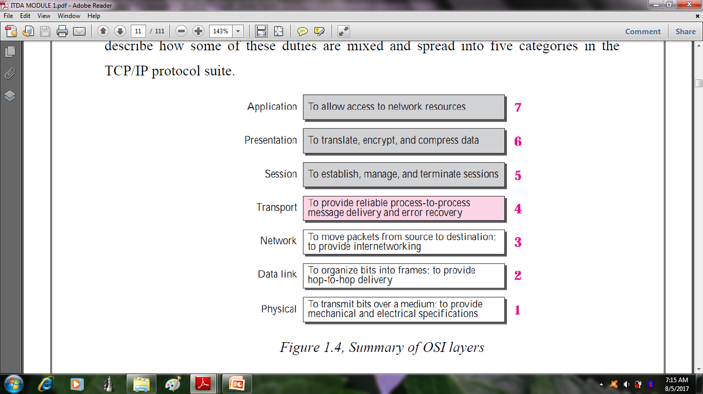
Summary of OSI Layers

Slide 48
Internet protocol stack
application: supporting network applications
FTP, SMTP, HTTP
transport: process-process data transfer
TCP, UDP
network: routing of datagrams from source to destination
IP, routing protocols
link: data transfer between neighboring network elements
Ethernet
physical: bits “on the wire”
application
transport
network
link
physical

Slide 49
Internet protocol stack
Application Layer
The application layer is where network applications and their application-layer protocols reside.
The Internet’s application layer includes many protocols, such as the HTTP protocol (which provides for Web document request and transfer), SMTP (which provides for the transfer of e-mail messages), and FTP (which provides for the transfer of files between two end systems).

Slide 50
Internet protocol stack
Application Layer
Certain network functions, such as the translation of human-friendly names for Internet end systems like www.ietf.org to a 32-bit network address, are also done with the help of a specific application-layer protocol, namely, the domain name system (DNS)

Slide 51
Internet protocol stack
Transport Layer
The Internet’s transport layer transports application-layer messages between application endpoints.
In the Internet there are two transport protocols, TCP and UDP, either of which can transport application-layer messages.

Slide 52
Internet protocol stack
Transport Layer
TCP provides a connection-oriented service to its applications.
This service includes guaranteed delivery of application-layer messages to the destination and flow control (that is, sender/receiver speed matching).
Transport-layer packet as a segment.

Slide 53
Internet protocol stack
TCP also breaks long messages into shorter segments and provides a congestion-control mechanism, so that a source throttles its transmission rate when the network is congested.
The UDP protocol provides a connectionless service to its applications.
This is a no-frills service that provides no reliability, no flow control, and no congestion control.

Slide 54
Internet protocol stack
Network Layer
The Internet’s network layer is responsible for moving network-layer packets known as datagrams from one host to another.
The Internet transport-layer protocol (TCP or UDP) in a source host passes a transport-layer segment and a destination address to the network layer.

Slide 55
Internet protocol stack
Network Layer
The network layer then provides the service of delivering the segment to the transport layer in the destination host.
The Internet’s network layer includes the IP Protocol, which defines the fields in the datagram as well as how the end systems and routers act on these fields.

Slide 56
Internet protocol stack
Network Layer
There is only one IP protocol, and all Internet components that have a network layer must run the IP protocol.
The Internet’s network layer also contains routing protocols that determine the routes that datagrams take between sources and destinations.
The Internet has many routing protocols

Slide 57
Internet protocol stack
Link Layer
Data transfer between neighboring network elements
Physical Layer
While the job of the link layer is to move entire frames from one network element to an adjacent network element, the job of the physical layer is to move the individual bits within the frame from one node to the next.

Slide 58
Internet protocol stack
The protocols in this layer are again link dependent and further depend on the actual transmission medium of the link (for example, twisted-pair copper wire, single-mode fiber optics).
For example, Ethernet has many physical-layer protocols:
one for twisted-pair copper wire, another for coaxial cable, another for fiber, and so on.
In each case, a bit is moved across the link in a different way.

Slide 59
ISO/OSI reference model
presentation: allow applications to interpret meaning of data, e.g., encryption, compression, machine-specific conventions
session: synchronization, checkpointing
Internet stack “missing” these layers!
these services, if needed, must be implemented in application layer
application
presentation
session
transport
network
link
physical

Slide 60
Encapsulation
source
message
M
application
transport
network
link
physical
segment
H_{t}
M
H_{t}
datagram
H_{n}
H_{n}
H_{t}
M
frame
H_{l}
H_{n}
H_{t}
M
link
physical
switch
destination
H_{n}
H_{t}
M
network
link
physical
M
application
transport
network
link
physical
H_{l}
H_{n}
H_{t}
M
H_{n}
H_{t}
M
H_{t}
M
H_{n}
H_{t}
M
H_{l}
H_{n}
H_{t}
M
router

